Slide 1
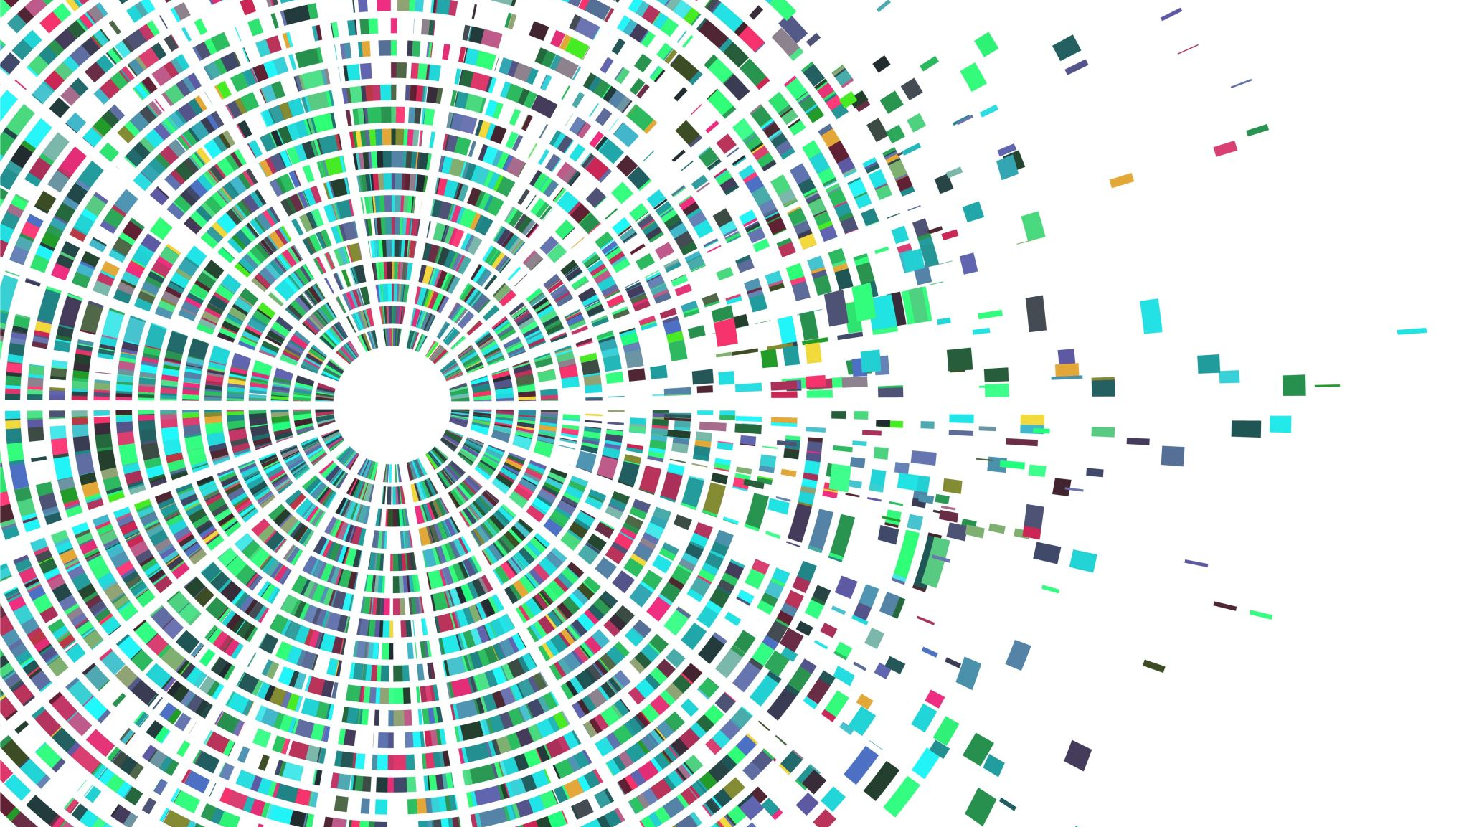
Proofs
Lecture 6
Disproof
By Ariel Avshalom

Slide 2
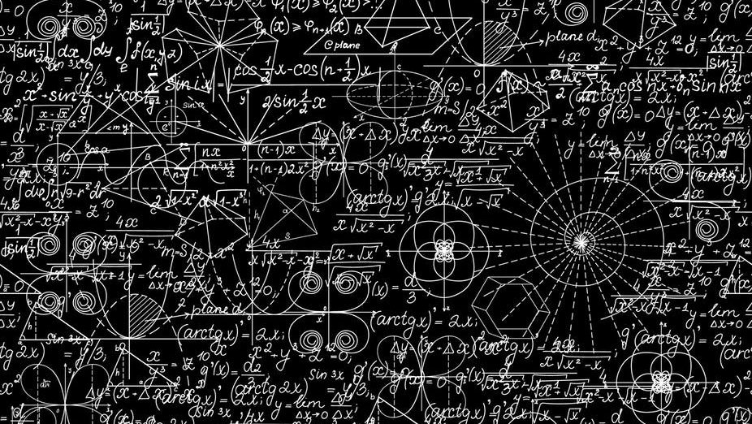
Reverse your thinking!
So far, we covered these proof methods:
Logical proofs (truth tables, equivalences)
Direct proofs (start with some statement and build it up)
Contrapositive proofs (try proving the contrapositive statement)
Proofs by contradiction (find a logical kerfuffle)
Set proofs (is my thingamajig an element of some set?)
If and only if proofs (prove something both ways)

Slide 3
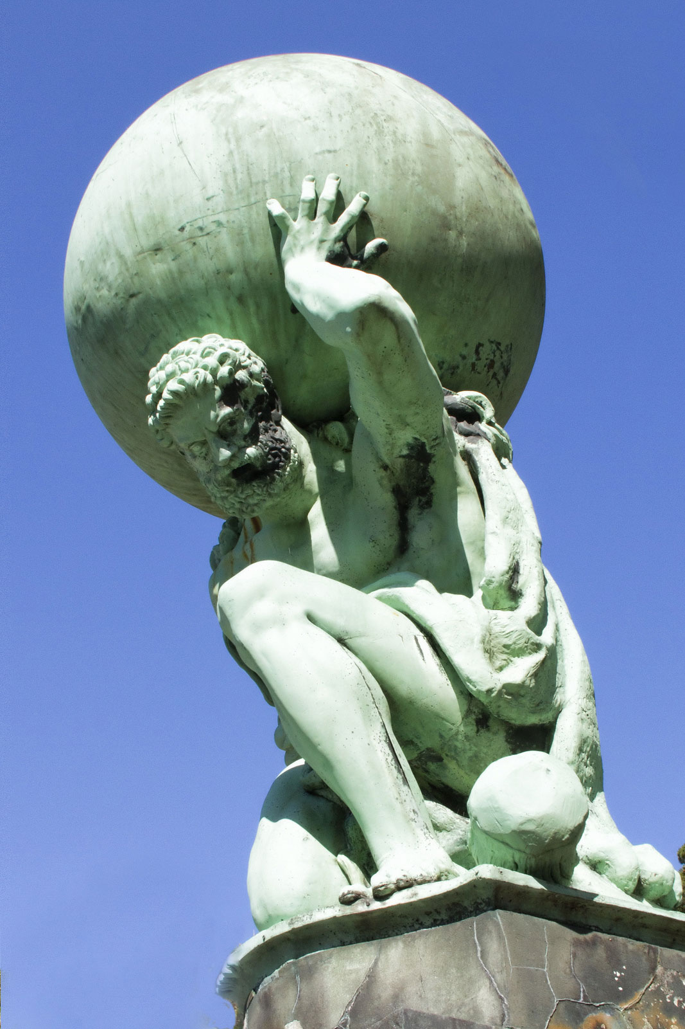
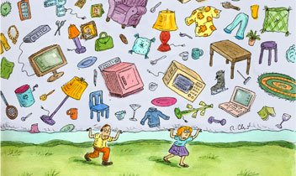
That’s a lot of stuff!

Slide 4


Note:
Due to unforeseen circumstances, we had to cut some of the examples I would have liked to cover:
Particularly, this was prevalent in if and only if (IFF) proofs.
The important thing to remember from IFF ⇔ proofs is that you need to prove something both ways:
$$P \text{⇒} Q$$
$$Q \text{⇒} P$$
This is just “like” proving two sets are equivalent to each other
(Remember that you can apply similar math principles to many places:)
You should practice these problems from the book for more

Slide 5
Instead of proving, lets disprove
So far we’ve been focused with proving statements, but what are some tools to show a statement is false?
Time for some definitions:

Slide 6
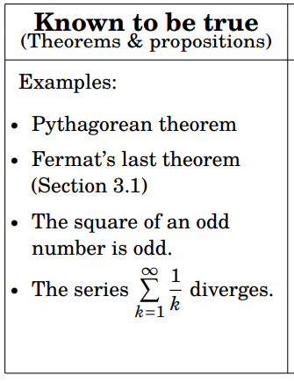
Theorems and Propositions
These are known to be true
Some examples are:

Slide 7
Conjectures
For whatever reason, some of the questions we ask in math are hard to prove AND they’re also hard to disprove
…
…
DRATZ

Slide 8


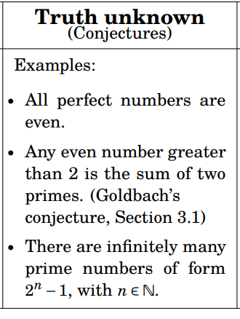

Examples
Another one to think of is the Collatz Conjecture
Its relatively simple sounding but even the greatest mathematicians have struggled with coming up with a proof

Slide 9
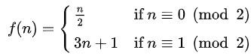
Collatz
Lothar Collatz was a fascinating mathematician from the 20th century
He proposed the 3n + 1 problem which Paul Erdos responded to with “Mathematics may not be ready for such problems”
Here is the problem:
Collatz said that if you input any natural number, eventually the loop will terminate at 1.

Slide 10



Graphic

Slide 11
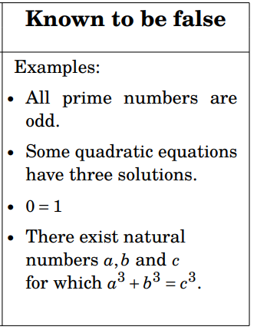
Mathematical Fallacy
There are some statements that have been disproved
We will cover some methods used to do this but it can get messy really fast

Slide 12
Can a computer prove a theorem?
Not really, or at least not yet
It is a really hard problem for people and its even harder for computers
But as we go along, it could be possible…just like its possible to program without coding today

Slide 13

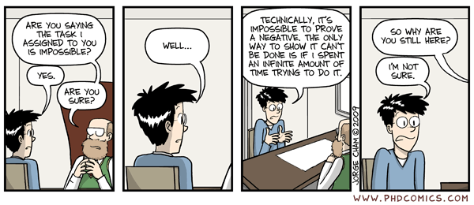
How to disprove a statement
Perhaps the most obvious way to think about it is if you’re trying to disprove P, find a proof for ¬P
To do this you need to understand how to negate statements
(Proving the absence of something)
It’s not impossible

Slide 14
Disproof by example (for ∀ proofs)
Let’s say your proof applies to a set of numbers
Then all you need to do is find one example where the proof is false

Slide 15
Statement: All prime numbers are odd
To show its false, look at 2
2 is prime but its even ⊥
(That’s why when people make this assertion, they also add a rider which says that for n > 2 this is true)
FALSE

Slide 16
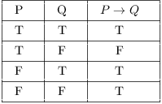

Disprove $\text{P}\text{(}\text{x}\text{) ⇒ }\text{Q}\text{(}\text{x}\text{)}$
Find an x where P(x) is true but Q(x) is false
This naturally comes from the conditional truth table

Slide 17
Disproving existence statements (for ∃ proofs)
If you want to disprove ∃ x ∈ S,P(x).
You would need to prove ¬ (∃ x ∈ S,P(x)) or
∀x ∈ S,∼ P(x)

Slide 18
Disproof by contradiction
If you want to disprove P, try this
Go through the steps of proving P and find a contradiction

